Slide 1
The PMRC Effects on Music Popularity

Slide 2
Outline
Hypothesis
The Data
Cool Graphs / Analysis
Conclusions

Slide 3
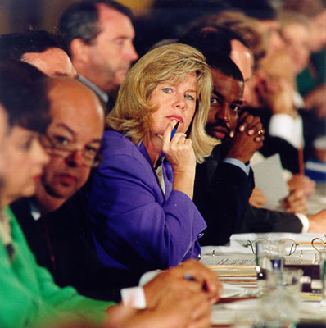
Hypothesis
Hypothesis
In the 1985, the Parents Music Resource Center (PMRC) pushed to put a warning label on 'explicit' music to help parents monitor the music their children were buying
Null hypothesis 1 - The average Hot 100 ranking of the songs in each of the genres (pop, rap/hip-hop, country, metal) is relatively equal before and after 1985
Null hypothesis 2 - The average number of popular explicit songs vs. not explicit songs before and after 1985 is relatively equal
I propose the alternate hypotheses are true
Rap, hip-hop and metal songs were more popular after 1985
Explicit songs were more popular after 1985
Notes:
In the mid to late 1980's, there was a big push to put a warning label on records and CD's that were deemed 'explicit' and had suggestive or 'satanic' lyrics. This was supposed to help parents monitor the music their children were buying. I propose it had the opposite effect. Albums and music with explicit lyrics and images were more popular after the mid to late 1980's.

Slide 4
The Data
Weekly Hot 100 singles chart between 1958 and 2019, over 300,000 records
Spotify, including song genres and an ‘explicit’ indicator, over 25,000 records
I merged these 2 files together for my analysis
I only used the top 75 songs to make the data manageable, about 14,000 records
Raw data available here

Slide 5
Assumptions
The music genre list by Spotify is accurate
Popularity determines total sales
Higher ranking in top 100 means higher total sales
Notes:
My determination of a single genre for each song is accurate

Slide 6
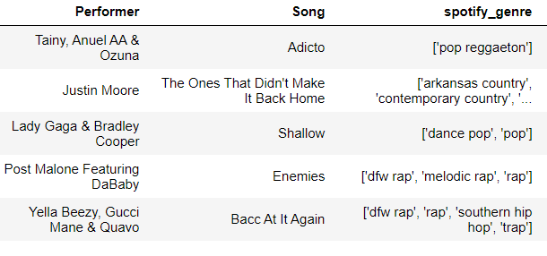
Example genre lists for individual songs:
I picked one genre out of each genre list: rap, hip-hop, pop, country or metal. I combined rap and hip-hop into one group.
Notes:
My determination of a single genre for each song is accurate

Slide 7
Cool Graphs

Slide 8
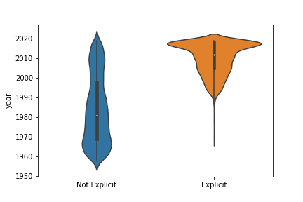


There were very few 'explicit' songs before 1985
vs.

Slide 9
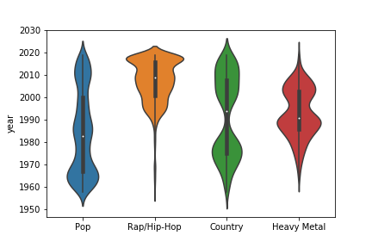




Rap and hip-hop became popular right after the PMRC was formed in 1985

Slide 10
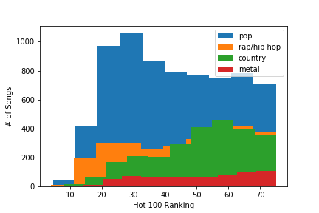
No significant difference in Hot 100 ranking between genres

Slide 11
The popularity of the songs in each of the genre groups by year was not normalized, so I used the Kruskal-Wallis and Mann-Whitney U tests to test my null hypothesis 1
The number of explicit vs not explicit songs by year was not normalized, so I used the Kruskal-Wallis and Mann-Whitney U tests to test my null hypothesis 2
Hot 100 lists - With 95% confidence, the popularity of rap, hip-hop and metal music increased dramatically after 1985, while pop and country stayed relatively steady
Spotify - With 95% confidence, explicit music as defined by Spotify became significantly more popular after 1985
Analysis Details

Slide 12
The stakeholders who would benefit from this research would be record label executives, band managers, and the performers themselves.
It would give them insight into what is popular at a certain point in time.
Record label executives could sign performers and bands that make music that is more popular, and increase their profits
Band managers and performers could focus on more popular music to increase their profits as well
This research is very interesting to me because I love music and I am against the censorship of music. Seeing explicit music become more popular after an attempt on censorship is very satisfying.
Stakeholders

Slide 13
Explicit music became significantly more popular after the PMRC was formed in 1985
Rap and Hip-Hop are more explicit on average than other types of music, especially after 1985
Because explicit music is more popular after 1985, sales of explicit music have significantly increased since then
Conclusions

Slide 14
Questions?

